Slide 1
Cardiovascular Dataset
EDA Presentation

Slide 2
Agenda
1
3
Tools &
Conclusion
Design
Data
Answers
2
4

Slide 3
Design
01

Slide 4
At This Point let’s see what we want to know from this dataset:
1
What is the most gender is exposed to be Cardiovascular Disease that has?
2
Is there a relationship between age and getting Cardiovascular Disease?
what is the age that has the most patient number of Cardiovascular Disease?
3
What is the most BMI that have a lot of infection by Cardiovascular Disease?
4
How many cholesterol patients have a Cardiovascular ?
5
SB pressure and DB pressure range that have a lot of cardiovascular?

Slide 5
Data
02

Slide 6
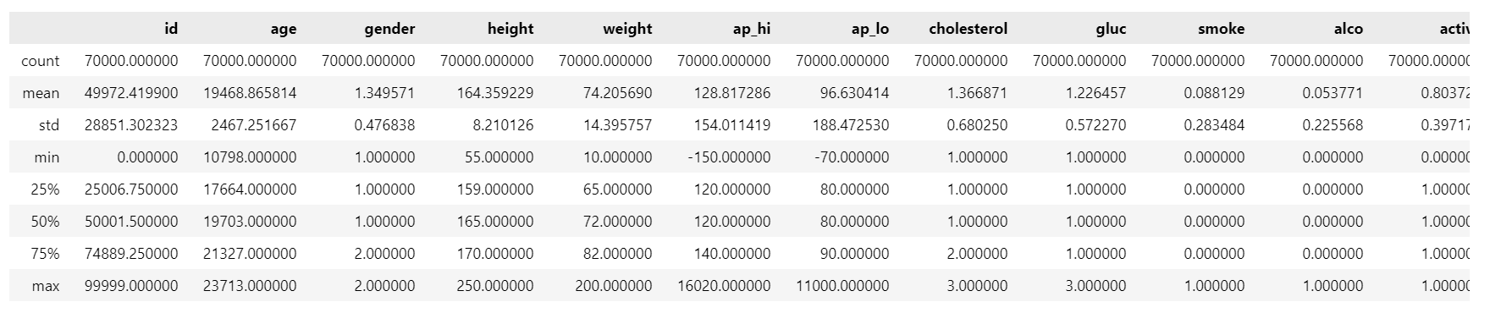
The Brief
This dataset has 70,000 observation and 13 column.
All of the dataset values were collected at the moment of medical examination.

Slide 7
BUT !
There is some outliers and wrong values

Slide 8
The Challenge
To clean the data and handle all outliers.

Slide 9
Ways for handling outliers
Drop.
Reassign values.

Slide 10
Answers
02

Slide 11
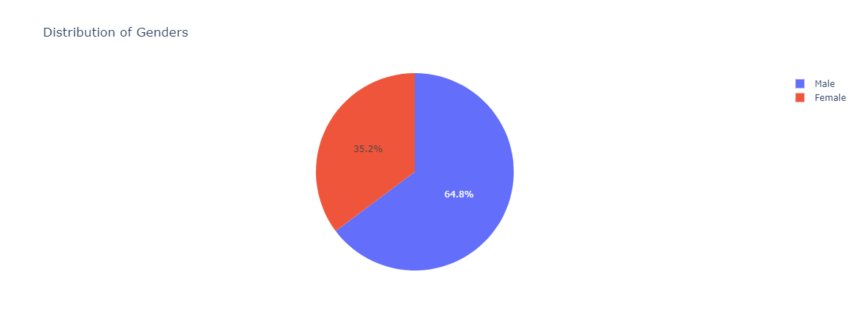
Q1:What is the most gender is exposed to be Cardiovascular Disease that has?

Slide 12
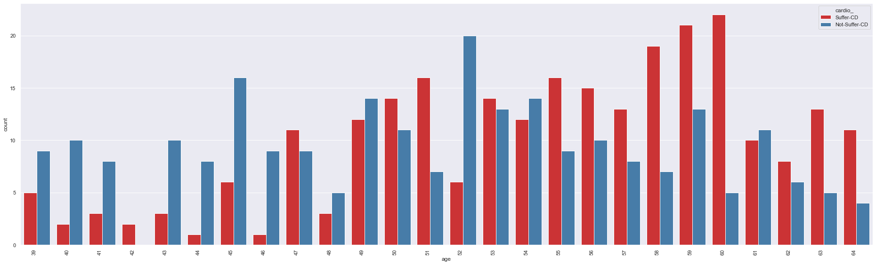
Q2:Is there a relationship between age and getting Cardiovascular Disease?
- what is the age that has the most patient number of Cardiovascular Disease?

Slide 13
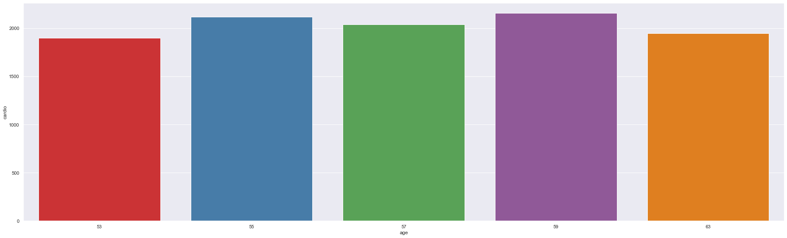

Slide 14
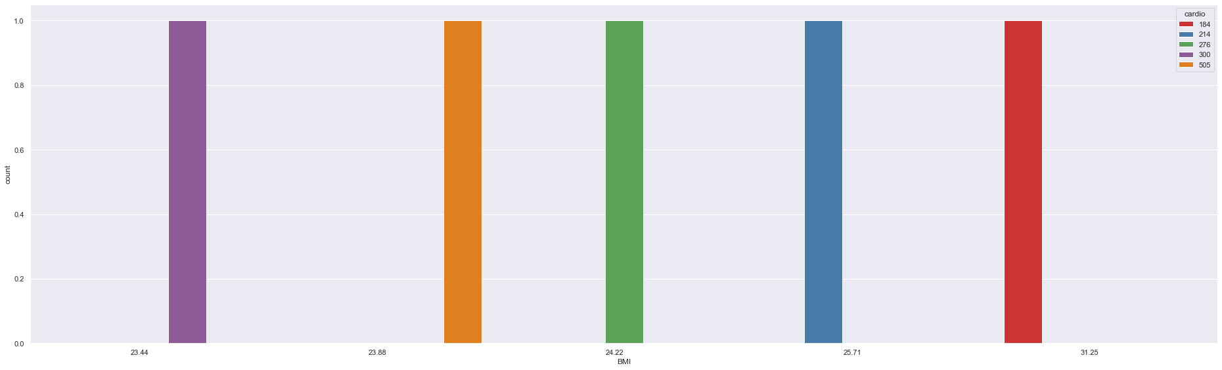
Q3: What is the most BMI that have a lot of infection by Cardiovascular Disease?

Slide 15
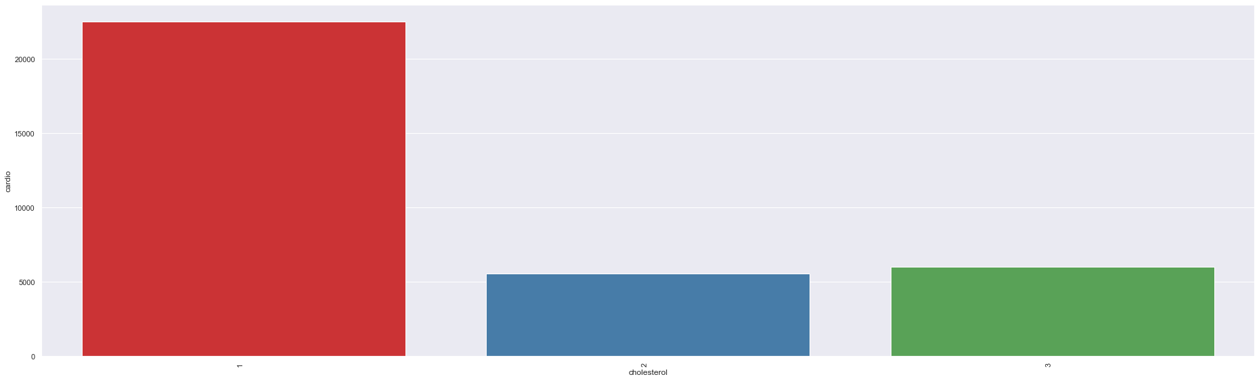
Q4: How many cholesterol patients have a Cardiovascular ?

Slide 16
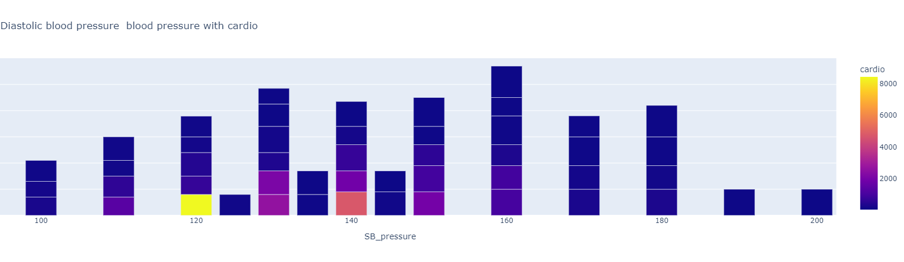
Q5: SB pressure and DB pressure range that have a lot of cardiovascular?

Slide 17
Tools
04

Slide 18





Programs and libraries:
Plotly
Pandas
Python
Numpy
VScode

Slide 19


